Slide 1
Discrete Mathematics
Dr. Han Huang
South China University of Technology
1

Slide 2
Chapter 5. Trees
Applications of Trees
Section 5.2
2

Slide 3
Contents
1
Binary Searching Trees
2
Decision Trees
3
Game Trees
3

Slide 4
§9.2: Applications of Trees
Binary search trees
A simple data structure for sorted lists
Decision trees
Minimum comparisons in sorting algorithms
Game trees

Slide 5
Binary Searching Trees
5

Slide 6
Binary Search Trees
A representation for sorted sets of items.
Supports the following operations in Θ(log n) average-case time:
Searching for an existing item.
Inserting a new item, if not already present.
Supports printing out all items in Θ(n) time.
Note that inserting into a plain sequence a_{i} would instead take Θ(n) worst-case time.

Slide 7
Binary Search Tree Format
Items are stored at individual tree nodes.
We arrange for the tree to always obey this invariant:
For every item x, Every node in x’s left subtree is less than x.
Every node in x’s right subtree is greater than x.
Example:
7
3
12
1
5
9
15
0
2
8
11

Slide 8
Recursive Binary Tree Insert
procedure insert(T: binary tree, x: item) v := root[T] if v = null then begin root[T] := x; return “Done” end else if v = x return “Already present” else if x < v then return insert(leftSubtree[T], x) else {must be x > v} return insert(rightSubtree[T], x)

Slide 9
Example 1
Mathematics
1 Physics > Mathematics
2 Geog.<Math.
Geography
3 Zoology > Math.
Zoology > Physics
Physics
Geology
Zoology
4 Mete. > Math.
Mete. < Physics
Meteorology
5 Geol. < Math.
Geol. > Geog.
Psychology
6 Psyc. > Math.
Psyc. > Phys.
Psyc. < Zoology

Slide 10
Decision Trees
10

Slide 11
Decision Trees
A decision tree represents a decision-making process.
Each possible “decision point” or situation is represented by a node.
Each possible choice that could be made at that decision point is represented by an edge to a child node.
In the extended decision trees used in decision analysis, we also include nodes that represent random events and their outcomes.

Slide 12
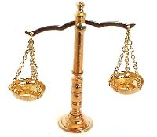
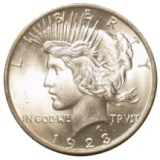
Coin-Weighing Problem
Imagine you have 8 coins, one of which is a lighter counterfeit.
No scale of weight markings is required for this problem!
How many weighings are needed to guarantee that the counterfeit coin will be found?
?

Slide 13
As a Decision-Tree Problem
In each situation, we pick two disjoint and equal-size subsets of coins to put on the scale.
The balance then “decides” whether to tip left, tip right, or stay balanced.
A given sequence of weighings thus yields a decision tree with branching factor 3.

Slide 14
Applying the Tree Height Theorem
The decision tree must have at least 8 leaf nodes, since there are 8 possible outcomes.
In terms of which coin is the counterfeit one.
Recall the tree-height theorem, h≥⎡log_{m}⎤.
Thus the decision tree must have height h ≥ ⎡log₃8⎤ = ⎡1.893…⎤ = 2.
Let’s see if we solve the problem with only 2 weighings…

Slide 15
Theorem 1
Theorem 1: A sorting algorithm based on binary comparison requires at least ⎡log n!⎤ comparisons.
Proof : The complexity of a sort based on binary comparisons is measured in terms of the number of such comparisons used.
The largest number of binary comparisons ever needed to sort a list with n elements gives the worst-case performance of the algorithm.
The most comparisons used equals the longest path length in the decision tree.

Slide 16
Proof of Theorem 1
The largest number of comparisons ever needed is equal to the height of the decision tree.
Since the height of a binary tree with n! leaves is at least ⎡log n!⎤ (using Corollary 1 in Section 9.1), at least ⎡log n!⎤ comparisons are needed.
The proof is finished.
We need note that ⎡log n!⎤ is Θ(n log n), one of the commonly used reference functions for the computational complexity of algorithms.
See Corollary 1 and Theorem 2.

Slide 17
A Decision Tree for Sorting
a : b
a>b
b>a
a : c
b : c
a>c
a<c
b>c
b<c
b : c
c>a>b
a : c
c>b>a
b>c
b<c
a>c
a<c
a>b>c
a>c>b
b>a>c
b>c>a

Slide 18
Game Trees
18

Slide 19
Game Trees
Game Trees : the vertices of these trees represent the positions that a game can be in as it progresses; the edges represent legal moves between these position.
The root represents the starting position.
Game trees may be infinite when the games they represent never end.
The leaves of a game tree represent the final positions of a game.

Slide 21
2 2 1
2 2
2 1 1
2 1
2 1
2
2 1
1 1
1 1 1
2
1
1 1
2
1 1
1
1
2
1 1
1
1
1 1
1
-1
1
+1
+1
+1
+1
+1
+1
1
1
1
1
1
-1
-1
-1
-1
-1

Slide 22
About Nim
本世纪初，哈佛大学数学系副教授查理士．理昂纳德．包顿 (Chales Leonard Bouton) 提出一篇极详尽的分析和证明，利用数的二进位表示法，解答了这个游戏的一般法则：对任意列数的铜板，每列有任意枚数，如何取得致胜之道？

Slide 23
在包顿的术语中，拿过后剩下的残局不是安全 (safe) 就是不安全 (unsafe) 的局面。
在所有安全的情况下，不管对方如何拿总是出现不安全的情况，你可以再取适当枚数的铜板（在适当的某一列），达到另一安全的情况，这样一直到拿光铜板为止，当然最后一次拿光铜板的一定是你。
反之，你如果留下不安全的情况，对方必有方法在适当的某一列，取走适当枚数的铜板，达到他的安全情况，也就是说你输定了。

Slide 24
包顿的方法很简单。首先，将各列铜板的枚数化成二进位数，相加，但不进位，然后再看和的各个位数。
如果和的各个位数都是偶数，则表示为安全残局;否则，如果有一位是奇数，则为不安全残局。
例如「三、四、五」游戏，一开始就是不安全残局，先拿的人可以适当取二枚而造成他的安全残局。

Slide 25
为什么安全残局和不安全残局可以利用上述的方法判定呢？
这个道理其实很简单。首先，如果将各列铜板数化为二进位表示法，相加，但不进位，得到的各个位数都是偶数的话，不论对方取那一列，多少枚铜板，则那一列铜板数所对应的二进位表示法中，必有某一位或数位由 0 变成 1 或者由 1 变成 0，其相加的和也相对的有某一位或数位由偶数变成奇数.

Slide 26
相反的，如果和的某一位或数位是奇数，则我们有办法在某一列取走适当枚数的铜板，使得新的和的各个位数都是偶数。
首先，选取和中所有为奇数的各个位数；其次看这些位数中哪一个是最左边一位；
找某一列，使其二进位表示法在此位上刚好是 1；
然后将此列的铜板数所对应的二进位数中，凡是和中为奇数的位数，都改变其数值，即若为 0 则变为 1，若为 1 则变为 0;
如此得到一新数，我们只要在此列铜板取走适当的数目，使达到这新的枚数，即可以使新的和的各个位数都是偶数。

Slide 27
About Tic-Tac-Toe
“井字棋”游戏（又叫“三子棋”），是一款十分经典的益智小游戏，想必很多人都有玩过。
“井字棋”的棋盘很简单，是一个3×3的格子，很像中国文字中的“井”字，所以得名“井字棋”。
“井字棋”游戏的规则与“五子棋”十分类似，“五子棋”的规则是一方首先五子连成一线就胜利；“井字棋”是一方首先三子连成一线就胜利。

Slide 28
1
2
3
4
5
6
7
8
9

Slide 29
在一个3*3的棋盘里，每人轮流下，只要任何方向，三个相同的子连成一线就算赢）感觉似乎有一定的规律，发现不管怎么下，总可以下和棋。
首先看有没有赢的机会，要是有的话其他什么都不用管了。
没有赢，就考虑是否攻击或者考虑最佳防守方式，要是这两种都不存在，那就可以随机了，当然随机也一定要合理。
比如：最中间的位置是最好的位置，其次是边角，最后才考虑边缘。

Slide 31
永远不会输的算法：
为棋盘的每个位置初始化用一个二维数组来记录，设置相应的权值。
中间的为3，边角的为2，边缘为1。随着棋子的增加改变每个位置的权值。
轮到自己走时，以自己方边缘每个棋子向两边搜索，中间的八叉搜索。
如果碰见同行或列上有或八叉上有自己的棋子，则给那个棋子改变权值+1。
搜索完毕后，计算每个方向的权值找出相应的落子位置，如果相同，则随机产生位置位置。

Slide 32
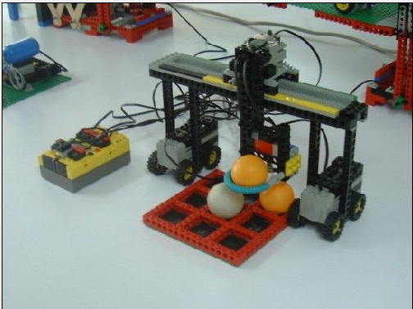
会下井字棋的机器人

Slide 33
Game Trees
Definition 1: The value of a vertex in a game tree is defined recursively as:
(i) the value of a leaf is the payoff to the first player when the game terminates in the position represented by this leaf.
(ii) the value of an internal vertex at even level is the maximum of values of its children, and the value of an interval at an odd level is the minimum of the values of its children.

Slide 34
Game Trees
The strategy where the first player moves to a position represented by a child with maximum value
and the second player moves to position of a child with minimum value is called the minmax strategy.
Both players follow the minmax strategy by calculating the value of the root of the tree; this value is called the value of the tree.

Slide 35
Theorem of Game Trees
Theorem 3: The value of a vertex of a game tree tells us the payoff to the first player.
if both players follow the minmax strategy and play starts from the position represented by this vertex.
Proof : If the vertex is a leaf, by definition the value assigned to this vertex is the payoff to first player.

Slide 36
Theorem of Game Trees
The inductive hypothesis is the assumption that the values of the children of a vertex are the payoffs to the first player,
assuming that play starts at each of the positions represented by these vertices.
Two case : it is the first player’s turn and it is the second player’s turn.

Slide 37
+1
2 2 1
+1
2 2
-1
2 1 1
-1
2 1
+1
2 1
2
+1
2 1
1 1
1 1 1
2
1
1 1
+1
+1
-1
+1
-1
+1
2
1 1
1
1
2
1 1
1
1
1 1
1
1
-1
-1
+1
+1
-1
-1
-1
+1
+1
+1
+1
1
1
1
1
1
-1
-1
-1
-1
-1

Slide 38
Applications
38

Slide 39
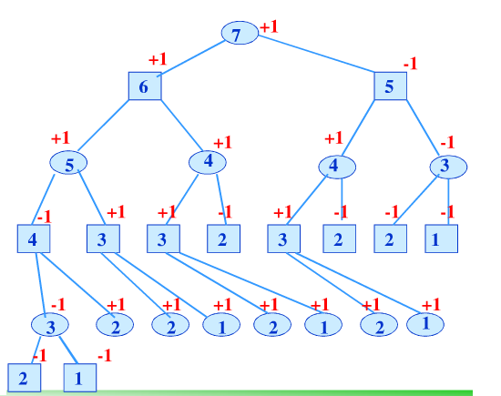
Applications
1.有n根火柴，甲乙两个依次可以从中任意取走1根或2根，但不能不取，取走最后一根火柴者为胜方（甲方先取），试讨论取胜策略。为便于理解，不妨设n=7。

Slide 40
Applications
在树形图中，圆圈中数字7表示轮到甲方取时还有7根，方框中数字6表示轮到乙方取时还有6根，以此类推。显然，一旦最后出现方框（1或2）状态时乙方胜（用-1表示），其余情况则为甲方胜（用+1表示）。
我们采用树的表示方法就能够推断出甲乙双方的胜负情况。

Slide 41
Applications
不难看出，如果n=3k(k为正整数)，假定先取者拿走a根（1或2），则后者只要取走3-a根，那么剩下火柴数目为3(k-1)根，则先取者必败。如果n不等于3k，则先取者取a根，使n-a=3k，则先取者必胜。
其余n=m*k的情况如此类推。

Slide 42
Applications
2.求含n个元素的集合的幂集

Slide 43
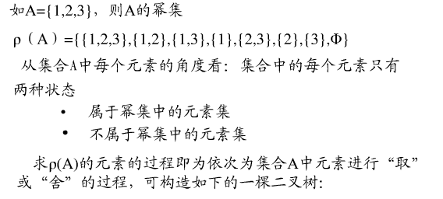
Applications
2.求含n个元素的集合的幂集

Slide 44
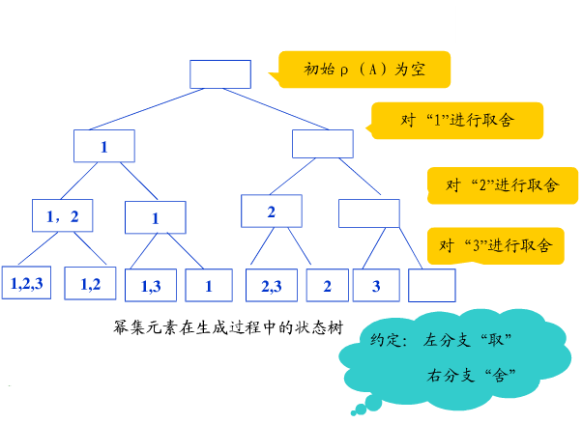
Applications
2.求含n个元素的集合的幂集

Slide 45
Applications
3.假设英文字母a，c，d，e，n，s，t，u出现的频率分别为13%，9%，16%，8%，7%，11%，6%，11%，求传输他们的最佳前缀码，并给出student at scut的编码信息。

Slide 46
Applications
3.假设英文字母a，c，d，e，n，s，t，u出现的频率分别为13%，9%，16%，8%，7%，11%，6%，11%，求传输他们的最佳前缀码，并给出student at scut的编码信息。
00001000011011001010100 0110100 00011101010100

Slide 47
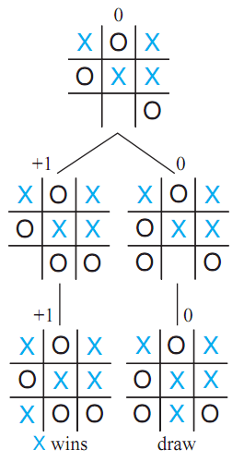
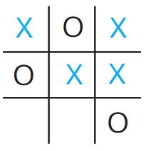
Exercises
1. Draw the subtree of the game tree for tic-tac-toe beginning at each of these positions. The beginning status (root of game tree) is given by the following figure. Please determine the pay-off values of subtree and mark them (“+1” or “-1”) at the tree.
Notes:
好像涉及树

Slide 48
Exercises
2. The rule of the game of coins (硬币): at the start of a game, there are a pile (堆) of coins. Two players take turns (轮流) separating the pile of coins (The Figure 1 show the Game Tree of a pile which has five coins); a legal (合法的) move is that separate (分开) pile of coins (just choose one pile) into two piles with unequal (不相等的) numbers of coins (数量) (For example, in Figure 2, the pile of coins is separated into a pile with three coins and the other with four coins). A player without a legal move loses (For example, in Figure 3, the pile of coins is separated two piles with equal numbers of coins). If you start the game (assuming the pile has seven coins), can you make sure you will win? If not, give your reason.
Notes:
好像涉及树

Slide 49
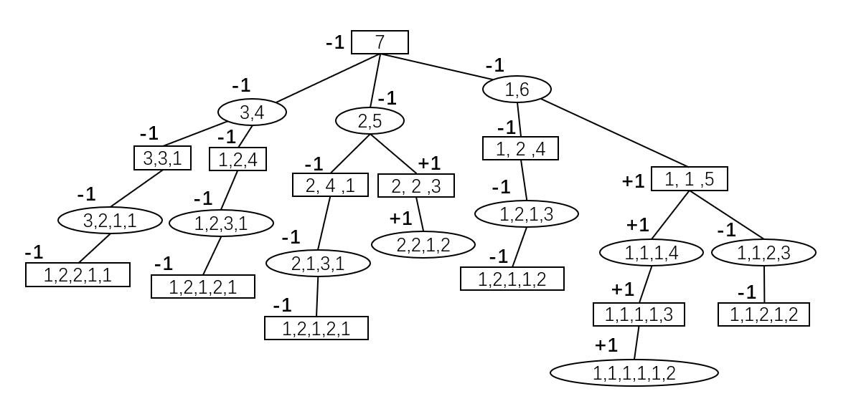
Exercises
Through the Minmax strategy can know that the first player will definitely lose. So, I can’t make sure I will win.
Notes:
好像涉及树

Slide 50
End of Section 5.2
Click to edit company slogan .
50

